Slide 1

5G IP-Core Network Planning and Optimization
Project Presentation:
Aditi Bhardwaj, Mohamad Azzam, Sajib Kumar Kuri
Course (SYSC5407): Plan and Design Computer Networks
Systems and Computer Engineering Department
Carleton University, Ottawa, Canada

Slide 2
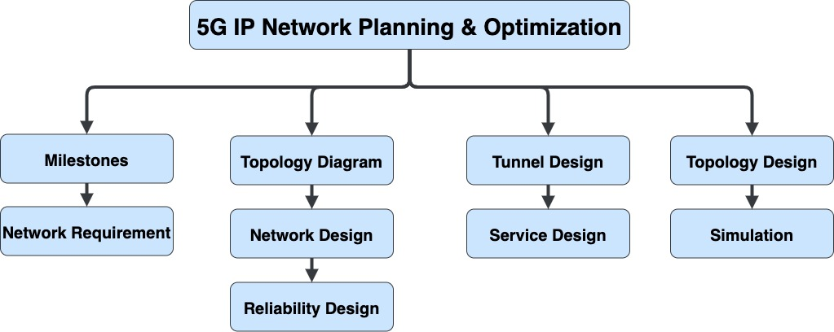
Topics
Milestones for 5G (Phase 1)
Network Requirement
Topology Diagram
Network Design
Protocol Design & Implementation
Simulation/Demo

Slide 3
Milestones for 5G
Service Based Architecture
Network functions offer their services via interfaces of a common framework to any network functions.
Network repository functions (NRF) allow to discover the services offered by other network functions.
Network Slicing
Set of technologies to create specialized, dedicated logical networks as a service (NaaS)
Flexible and customized design of functions, isolation mechanisms and O&M tools
Network slicing is capable to provide logical dedicated networks upon a common infrastructure.
Three fundamental network slice types for 5G:
uRLLC: Ultra Reliable Low Latency Communication
mMTC: Massive Machine Type Communication (IoT)
eMBB: Enhanced Mobile Broadband
IoT Application Support
In-Vehicle Infotainment, smart city, smart hospital, Smart Grid Automation
Common Core Network
Generalised 5G Core Network to operate with different Access Networks

Slide 4
Network Requirement
Operating System : Windows 10
Simulator : Huawei Versatile Routing Platform Software
VRP (R) software, Version 5.110 (eNSP V100R001C00)
Network Device: Routers-AR1220-S
Protocol: IS-IS, BGP, MPLS
Core Service (Source): 5G OTN, g-NodeB, IoT Gateway (EDGE/FOG)
Core Service Node (Destination): Billing Server, 5G-RNC, Cloud Server

Slide 5
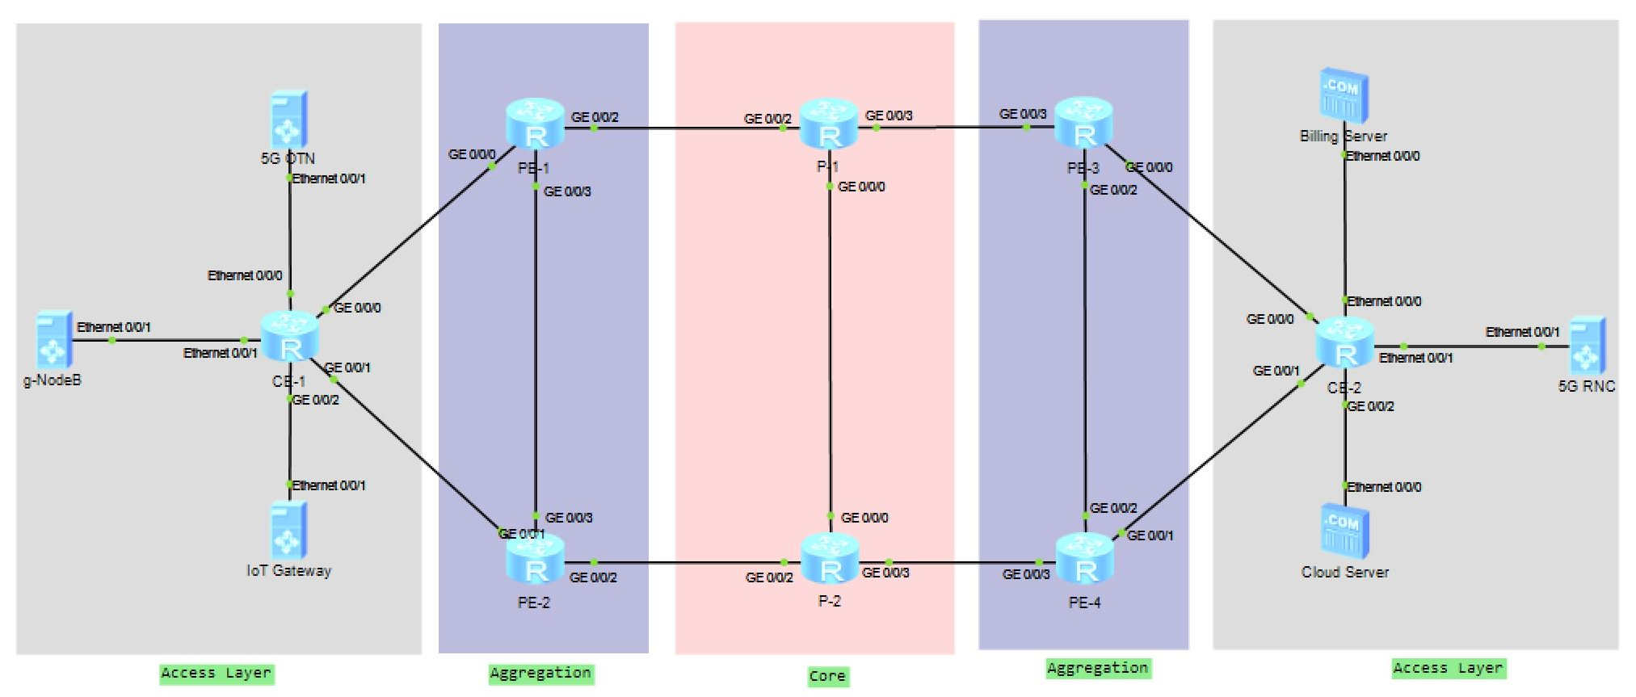
Topology Diagram

Slide 6
Network Design
We proposed hierarchical architecture H-VPN solution for 5G network consist of an access layer, an aggregation layer, and a core layer.
A BGP/MPLS IP-VPN network in a hierarchical structure assists with this conversion process.
The H-VPN solution distributes the functions of one PE to multiple PEs. These PEs playing different roles and form a hierarchical architecture.
H-VPN networking provides the following benefits:
Flexible expandability
Reduced interface resource requirements
Simple configuration

Slide 7
Network Design (Cont.)
The BGP/MPLS IP VPN model consists of the following parts:
A Customer Edge (CE) is an edge device on the customer network, which has one or more interfaces directly connected to the service provider network.
A Provider Edge (PE) is an edge device on the provider network, which is directly connected to the CE. In the MPLS network, PEs perform all the VPN-related processing.
A Provider (P) is a backbone device on the provider network, which is not directly connected to the CE. Ps only need to possess basic MPLS forwarding capabilities and do not need to maintain information about VPNs.

Slide 8
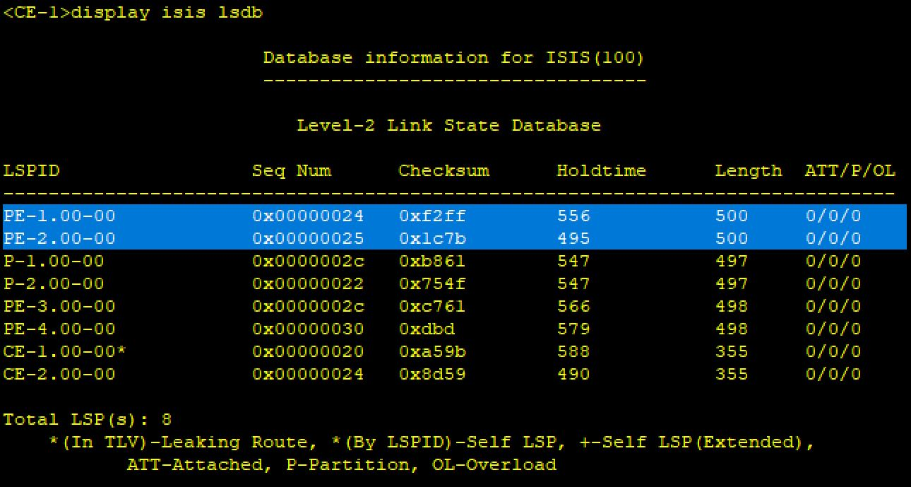
Interior Gateway Protocol
IS-IS is used inside an AS as IGP protocol, IS-IS is a link-state protocol which use SPF algorithm to calculate routes
IS-IS has been called the de facto standard for large service provider network backbones
IS-IS is easier to extend then OSPF and more secure than OSPF protocol
ISIS is more scalable, has less overhead and also support IPv4 and IPv6 in a single instance
Computation for large area is much less CPU and memory intensive than for OSPF

Slide 9
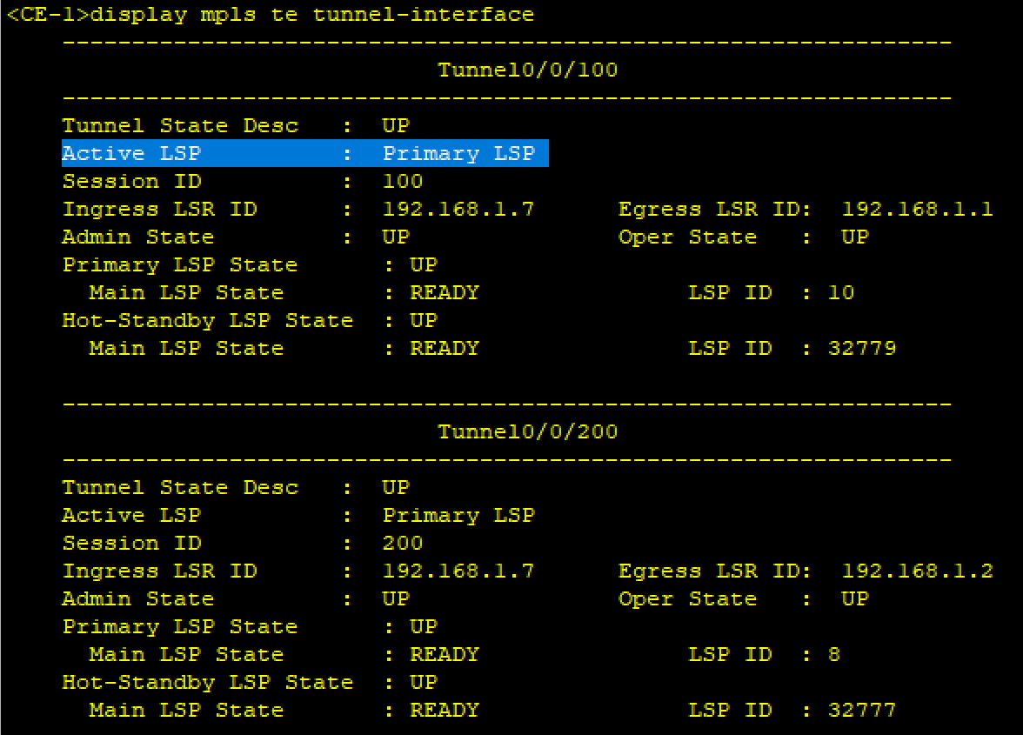
MPLS / H-VPN Tunnels Design
Multiprotocol Label Switching (MPLS) is a routing technique that directs data optimization based on the existing MPLS network
MPLS avoids complex lookups in a routing table and speeding traffic flows using labels
Adjusts traffic optimization on the backbone network and improves network bandwidth utilization
We used MPLS TE tunnels, including Resource Reservation Protocol-TE (RSVP-TE) and Hot-Standby policy.

Slide 10
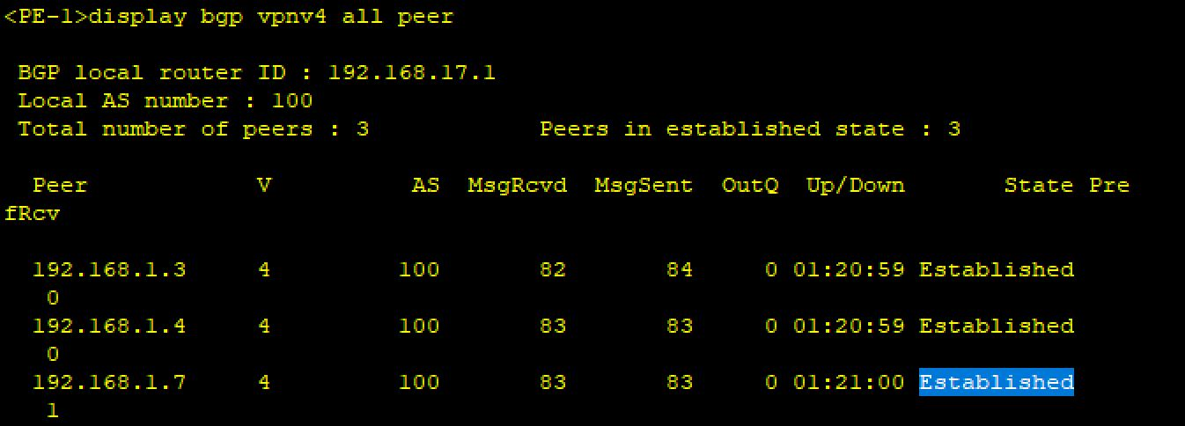
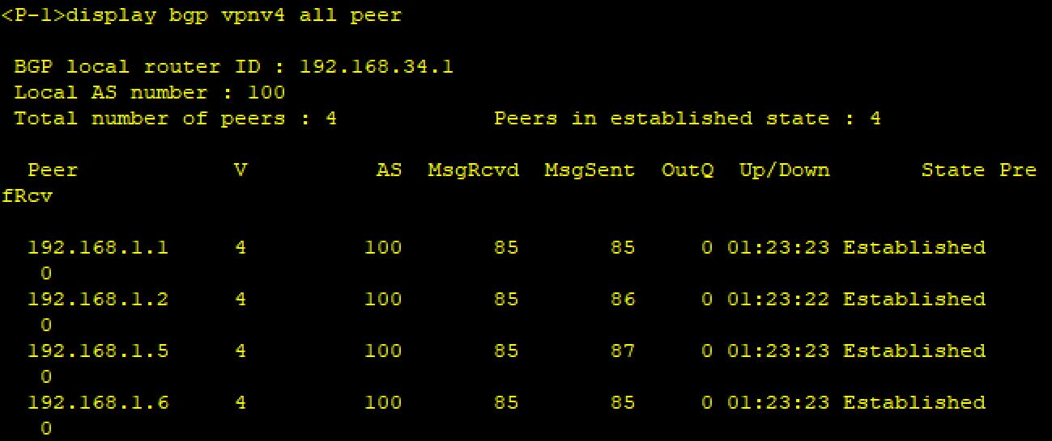
BGP Protocol
Border Gateway Protocol (BGP) is a dynamic routing protocol used between autonomous systems (AS)
Extensions for BGP-4 (MP-BGP) is used to support multiple types of network layer protocols such as VPNv4 address
To improve reliability, it is recommended that two BGP connections be deployed in the same area to provide redundancy protection.
We used, I-BGP connections in the network to forward 5G data-traffic for network optimization solution

Slide 11
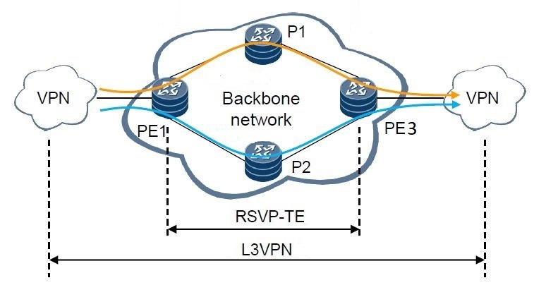
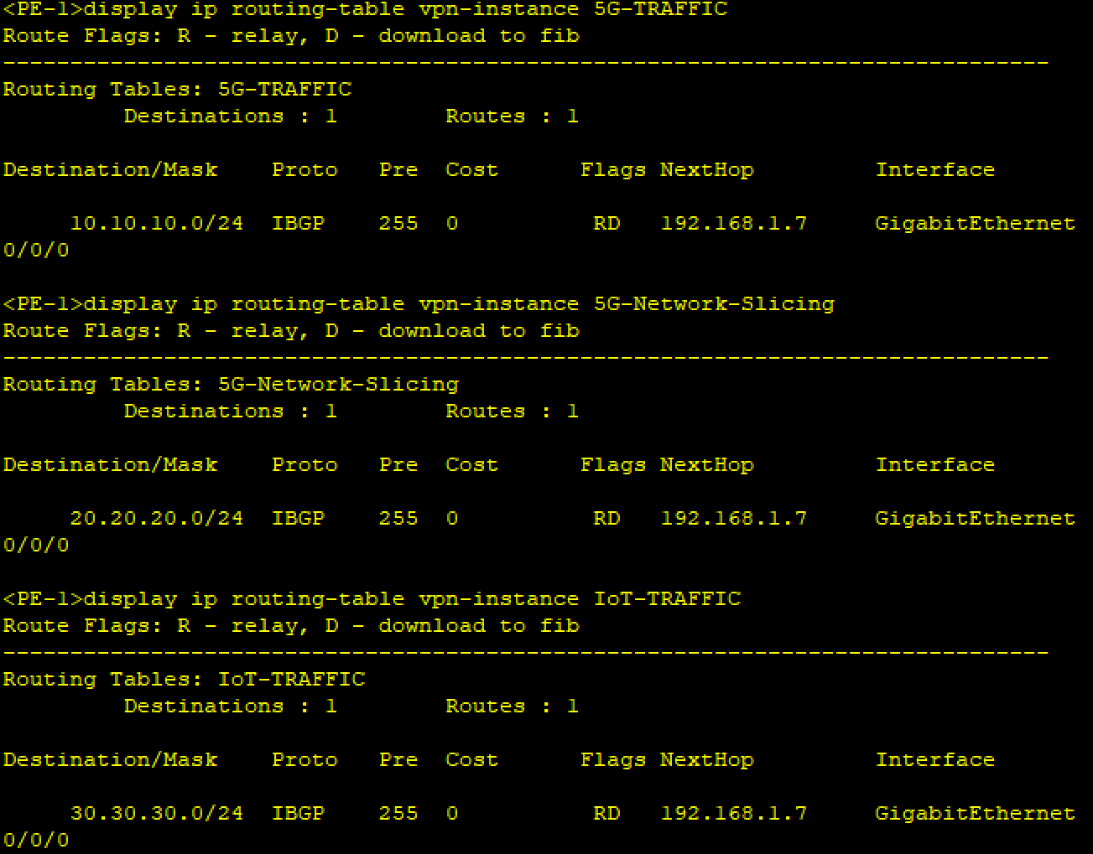
L3VPN Design

Slide 12
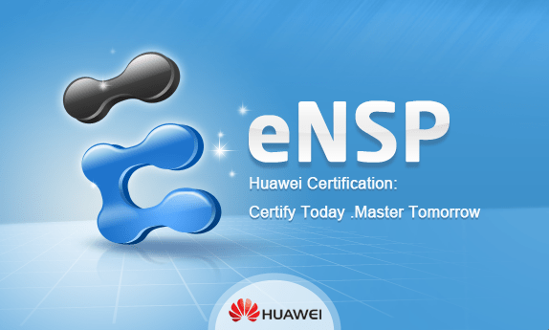
Demo/Simulation

Slide 13
THANK YOU s
?
Any Questions
27 November, 2019

